Slide 1
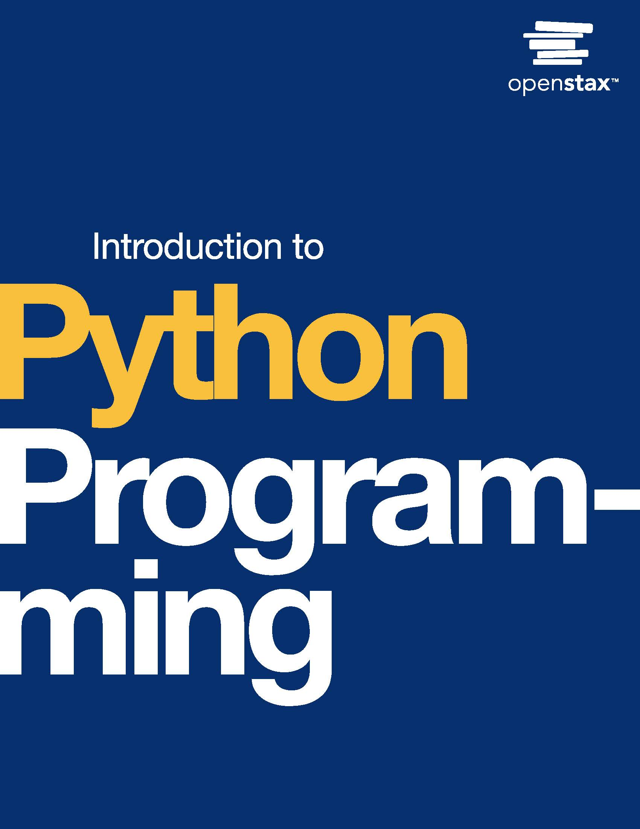
Introduction to Python Programming
Chapter 2: Expressions

Slide 2
Chapter outline
The Python shell (Visual studio terminal Shell)
Type conversion
Mixed data types
Floating-point errors
Dividing integers
The math module
Formatting code
Python careers

Slide 3
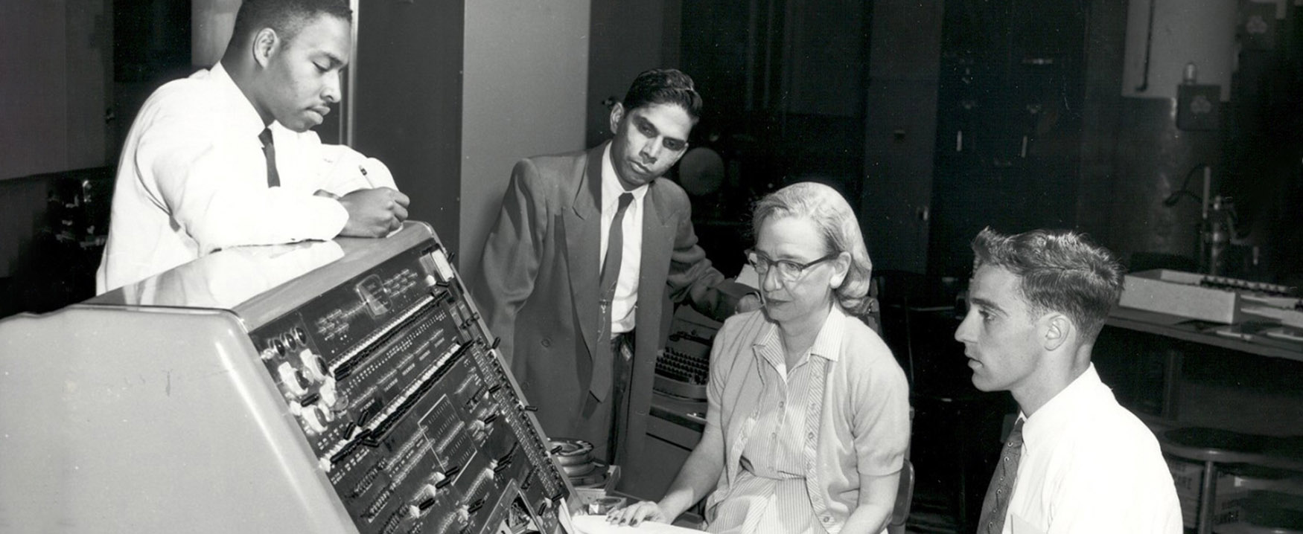
Figure 2.1
credit: modification of work "Grace Hopper at Univac I console", courtesy of the Computer History Museum
Notes:
Grace Murray Hopper at the UNIVAC keyboard

Slide 4
2.1 The Python shell
Learning Objectives
Use a Python shell to run statements and expressions interactively.
Explain the function of the up and down arrow keyboard shortcuts.

Slide 5
2.1 The Python shell
The interpreter (convert the code into machine code -binary-)
Python is a high-level language, meaning that the source code is intended for humans to understand.
Programs written in high-level languages must be translated into machine code to run. This translation process can happen all at once, or a little at a time, depending on the language.
Python is an interpreted language: the source code is translated one line at a time while the program is running.
The Python interpreter translates source code into machine code and runs the resulting program. If and when an error occurs, the interpreter stops translating the source code and displays an error message.
A shell, also called a console or terminal, is a program that allows direct interaction with an interpreter.
The interpreter usually runs an entire program all at once. But the interpreter can run one line of code at a time within a Python shell

Slide 6
2.1 The Python shell
The arrow keys
The acronym REPL (pronounced "rep ul") is often used when referring to a shell. REPL stands for "read-eval-print loop," which describes the repetitive nature of a shell:
Read/input some code
Evaluate/run the code
Print any results
Loop back to step 1
Most shells maintain a history of every line of code the user types. Pressing the up or down arrow key on the keyboard displays the history.
The up arrow displays the previous line; the down arrow displays the next line. That way, the user can repeat a line without having to type the line again.

Slide 7
2.2 Type conversion
Learning Objectives
Explain how the interpreter uses implicit type conversion.
Use explicit type conversion with int(), float(), and str().

Slide 8
2.2 Type conversion
The Python interpreter uses implicit type conversion to automatically convert one data type to another.
Once distance is assigned with 252.5, the interpreter will convert distance from an integer to a float without the programmer needing to specify the conversion.

Slide 9
2.2 Type conversion
Explicit type conversion (forcing the conversion)
A programmer often needs to change data types to perform an operation.
Ex: A program should read in two values using input() and sum the values. Remember input() reads in values as strings. A programmer can use explicit type conversion to convert one data type to another.
int() converts a data type to an integer. Any fractional part is removed. Ex: int(5.9) produces 5.
float() converts a data type to a float. Ex: float(2) produces 2.0.
str() converts a data type to a string. Ex: str(3.14) produces "3.14".

Slide 10
2.3 Mixed data types
Learning Objectives
Identify the data types produced by operations with integers, floats, and strings.
Use operators and type conversions to combine integers, floats, and strings.

Slide 11
2.3 Mixed data types
Combining integers and floats
Programmers often need to combine numbers of different data types. Ex: A program computes the total for an online shopping order:
quantity = int(input()) price = float(input()) total = quantity * price print(total)quantity is an integer, and price is a float. So what is the data type of total? For input 3 and 5.0, total is a float, and the program prints 15.0.
Combining an integer and a float produces a float. A float is by default printed with at least one figure after the decimal point and has as many figures as needed to represent the value. Note: Division using the / operator always produces a float.

Slide 12
2.4 Floating-point errors
Learning Objectives
Explain numerical inaccuracies related to floating-point representation.
Use the round() function to mitigate floating-point errors in output.

Slide 13
2.4 Floating-point errors
Floating-point errors
Computers store information using 0's and 1's. All information must be converted to a string of 0's and 1’s.
Floating-point values are stored as binary by Python.
The conversion of a floating point number to the underlying binary results in specific types of floating-point errors.
A round-off error occurs when floating-point values are stored erroneously as an approximation.
The difference between an approximation of a value used in computation and the correct (true) value is called a round-off error.

Slide 14

Table 2.1 Round-off error. (caused by the binary conversion)

Slide 15
2.4 Floating-point errors
An overflow error occurs when a value is too large to be stored.
The maximum and minimum floating-point values that can be represented are 1.8×103081.8×10308 and −1.8×10308−1.8×10308, respectively.
Attempting to store a floating-point value outside the range (−1.8×10308,1.8×10308)(−1.8×10308,1.8×10308) leads to an overflow error.
Below, 3.02563.0256 and 3.05123.0512 can be represented, but 3.010243.01024 is too large and causes an overflow error.

Slide 16
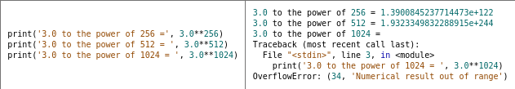
Table 2.2 Overflow error.(there is not enough space to write the number)

Slide 17
2.5 Dividing integers
Learning Objectives
Evaluate expressions that involve floor division and modulo.
Use the modulo operator to convert between units of measure.

Slide 18
2.5 Dividing integers
Division and modulo
Python provides two ways to divide numbers:
True division (/) converts numbers to floats before dividing. Ex: 7 / 4 becomes 7.0 / 4.0, resulting in 1.75.
Floor division (//) computes the quotient, or the number of times divided. Ex: 7 // 4 is 1 because 4 goes into 7 one time, remainder 3.
The modulo operator (%) computes the remainder. Ex: 7 % 4 is 3.
Note: The % operator is traditionally pronounced "mod" (short for "modulo"). Ex: When reading 7 % 4 out loud, a programmer would say "seven mod four."

Slide 19
2.5 Dividing integers
Unit conversions
Division is useful for converting one unit of measure to another. To convert centimeters to meters, a variable is divided by 100. Ex: 300 centimeters divided by 100 is 3 meters.
Amounts often do not divide evenly as integers. 193 centimeters is 1.93 meters, or 1 meter and 93 centimeters. A program can use floor division and modulo to separate the units:
The quotient, 1 meter, is 193 // 100.
The remainder, 93 centimeters, is 193 % 100.
Programs often use floor division and modulo together. If one line of code floor divides by m, the next line will likely modulo by m. The unit m by which an amount is divided is called the modulus. Ex: When converting centimeters to meters, the modulus is 100.

Slide 20
2.6 The math module
Learning Objectives
Distinguish between built-in functions and math functions.
Use functions and constants defined in the math module.

Slide 21
2.6 The math module
Importing modules
Python comes with an extensive standard library of modules.
A module is previously written code that can be imported in a program. The import statement defines a variable for accessing code in a module. Import statements often appear at the beginning of a program.
The standard library also defines built-in functions such as print(), input(), and float(). A built-in function is always available and does not need to be imported. The complete list of built-in functions is available in Python's official documentation.
A commonly used module in the standard library is the math module. This module defines functions such as sqrt() (square root).

Slide 22
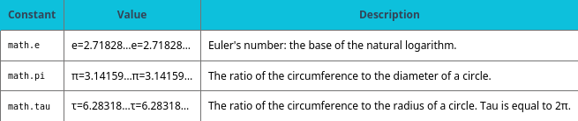
Table 2.3 Example constants in the math module.

Slide 23
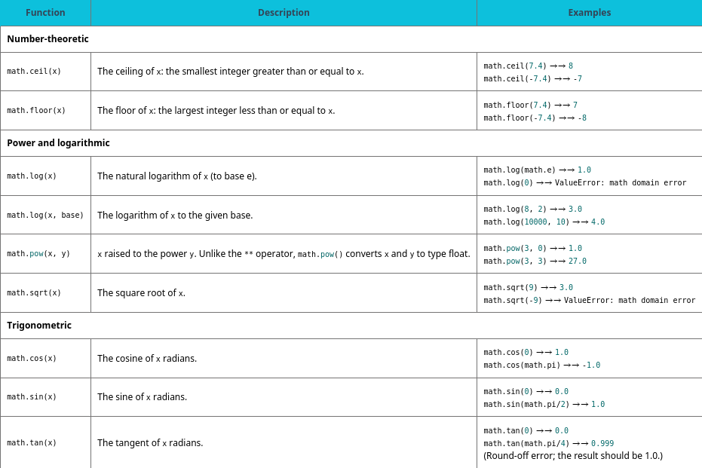
Table 2.4 Example functions in the math module.

Slide 24
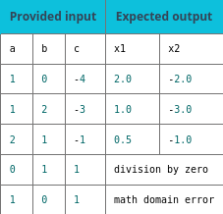
Table 2.5

Slide 25
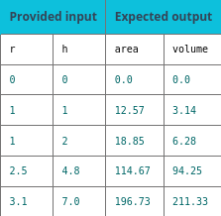
Table 2.6

Slide 26
2.7 Formatting code
Learning Objectives
Identify good spacing for expressions and statements.
Write multi-line statements using implicit line joining.

Slide 27
2.7 Formatting code
Recommended spacing
Most spaces in Python code are ignored when running programs; however, spaces at the start of a line are very important.
The following two programs are equivalent:
Good spacing: name = input("Enter someone's name: ") place = input("Enter a famous place: ") print(name, "should visit", place + "!")
Poor spacing: name=input ("Enter someone's name: " ) place =input("Enter a famous place: ") print( name,"should visit" , place+ "!")

Slide 28
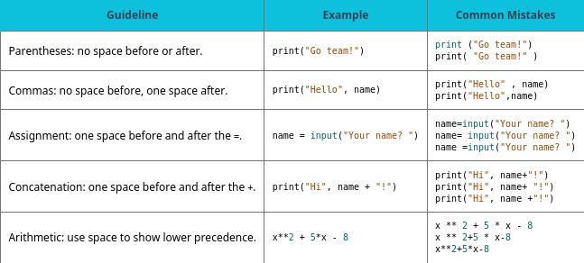
Table 2.7 Guidelines for spaces.

Slide 29
2.8 Python careers
Learning Objectives
Summarize how Python is used in fields other than CS and IT.
Describe two different kinds of applications made with Python.

Slide 30
2.8 Python careers
Example job titles include software engineer, data scientist, web developer, and systems analyst.
These jobs often require a degree in computer science (CS), information technology (IT), or a related field. However, programming is not limited to these fields and careers.
Python programs can automate tasks and solve problems quickly.

Slide 31
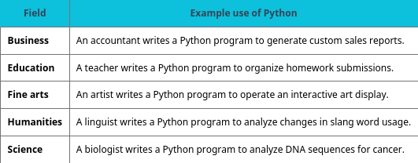
Table 2.8 Python outside of CS and IT.

Slide 32
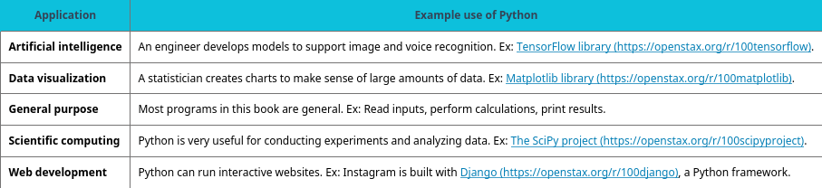
Table 2.9 Applications built with Python.

Slide 33
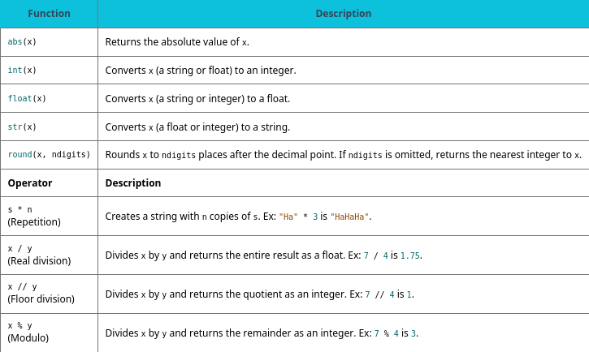
Table 2.10 Chapter 2 reference.

Slide 34
This ancillary resource is licensed under a Creative Commons Attribution-NonCommercial-ShareAlike 4.0 (CC BY NC-SA) license; it may be distributed, remixed, built upon for noncommercial purposes only, and must be attributed to OpenStax and redistributed under the same license.

